Slide 1
Background on Deep Learning
Urban Analytics Summer School
Bill Howe

Slide 2
Review: Machine Learning
Machine learning is a field of computer science that gives computers the ability to learn a function without being explicitly programmed
Labeled Data
Machine Learning algorithm
Training
Prediction
Labeled Data
Learned model
Prediction
Methods that can learn from and make predictions on data
slides adapted from Ismini Lourentzou

Slide 3
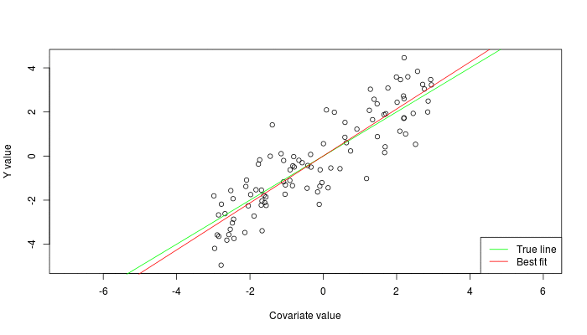


Review: Types of Learning
Supervised: Learning with a labeled training set
Example: email classification with already labeled emails
Unsupervised: Discover patterns in unlabeled data
Example: cluster similar documents based on text
Reinforcement learning: learn to act based on feedback/reward
Example: learn to play Go, reward: win or lose
class A
class A
Classification
Regression
Clustering
Anomaly Detection
Sequence labeling
…
http://mbjoseph.github.io/2013/11/27/measure.html
slides adapted from Ismini Lourentzou

Slide 4
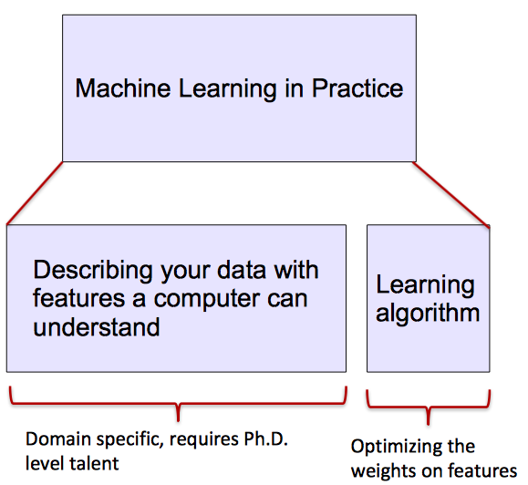
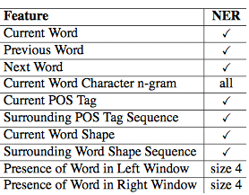
ML vs. Deep Learning
Most machine learning methods work well because of human-designed representations and input features
ML becomes just optimizing weights to best make a final prediction
slides adapted from Ismini Lourentzou

Slide 5

What is Deep Learning (DL) ?
A machine learning subfield of learning representations of data. Exceptional effective at learning patterns.
Deep learning algorithms attempt to learn (multiple levels of) representation by using a hierarchy of multiple layers
If you provide the system tons of information, it begins to understand it and respond in useful ways.
https://www.xenonstack.com/blog/static/public/uploads/media/machine-learning-vs-deep-learning.png
slides adapted from Ismini Lourentzou

Slide 6
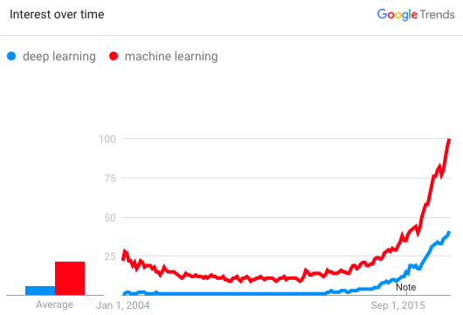
Why is DL useful?
Manually designed features are often over-specified, incomplete and take a long time to design and validate
Learned Features are easy to adapt, fast to learn
Deep learning provides a very flexible, (almost?) universal, learnable framework for representing world, visual and linguistic information.
Can learn both unsupervised and supervised
Effective end-to-end joint system learning
Utilize large amounts of training data
In ~2010 DL started outperforming other ML techniques
first in speech and vision, then NLP
slides adapted from Ismini Lourentzou

Slide 7
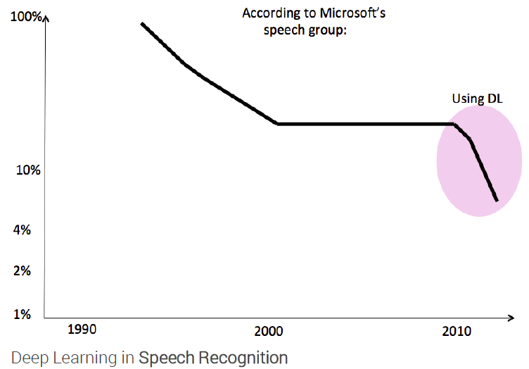
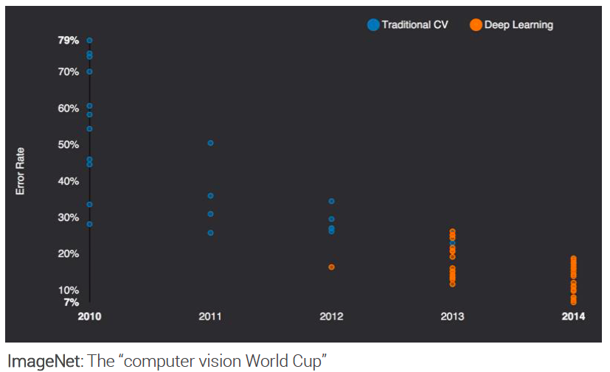
State of the art in …
Several big improvements in recent years in NLP
Machine Translation
Sentiment Analysis
Dialogue Agents
Question Answering
Text Classification …
Leverage different levels of representation
words & characters
syntax & semantics
slides adapted from Ismini Lourentzou

Slide 8
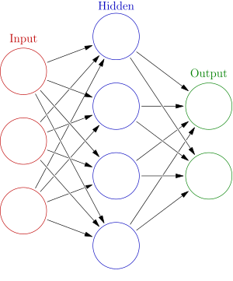


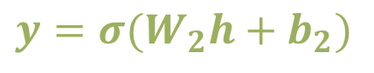
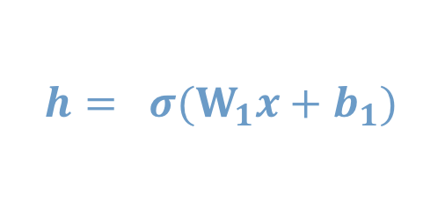

Neural Network Intro
Weights
$$h= σ(W_{1}x+b_{1})$$
$$y=σ(W_{2}h+b_{2})$$
Activation functions
How do we train?
$$y$$
$$x$$
4 + 2 = 6 neurons (not counting inputs)
[3 x 4] + [4 x 2] = 20 weights
4 + 2 = 6 biases
26 learnable parameters
$$h$$
Demo
slides adapted from Ismini Lourentzou
Notes:
Hyper-parameters

Slide 9

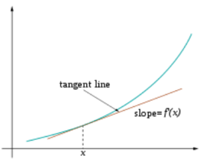
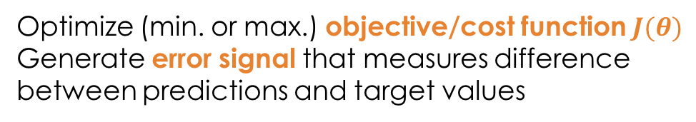
Training
Sample labeled data
(batch)
Forward it through the network, get predictions
Back-propagate the errors
Update the network weights
Optimize (min. or max.) objective/cost function $J(θ)$
Generate error signal that measures difference between predictions and target values
Use error signal to change the weights and get more accurate predictions
Subtracting a fraction of the gradient moves you towards the (local) minimum of the cost function
https://medium.com/@ramrajchandradevan/the-evolution-of-gradient-descend-optimization-algorithm-4106a6702d39

Slide 10
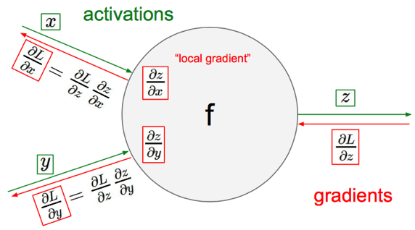
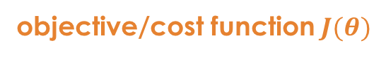
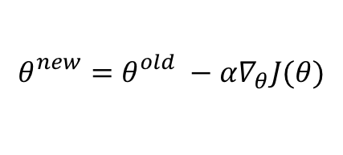
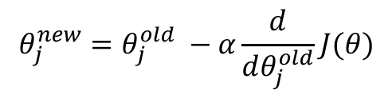
Gradient Descent
objective/cost function $J(θ)$
Review of backpropagation
$$θ_{j}^{new}=θ_{j}^{old} −α\frac{ⅆ}{ⅆθ_{j}^{old}}J(θ)$$
Update each element of θ
$$θ_{}^{new}=θ_{}^{old} −α∇_{θ}J(θ)$$
Matrix notation for all parameters
learning rate
Recursively apply chain rule though each node
Notes:
Adaptive Gradient Algorithm (AdaGrad) that maintains a per-parameter learning rate that improves performance on problems with sparse gradients (e.g. natural language and computer vision problems).
Root Mean Square Propagation (RMSProp) that also maintains per-parameter learning rates that are adapted based on the average of recent magnitudes of the gradients for the weight (e.g. how quickly it is changing). This means the algorithm does well on online and non-stationary problems (e.g. noisy).
Adam realizes the benefits of both AdaGrad and RMSProp.
Instead of adapting the parameter learning rates based on the average first moment (the mean) as in RMSProp, Adam also makes use of the average of the second moments of the gradients (the uncentered variance).
Specifically, the algorithm calculates an exponential moving average of the gradient and the squared gradient, and the parameters beta1 and beta2 control the decay rates of these moving averages.
The initial value of the moving averages and beta1 and beta2 values close to 1.0 (recommended) result in a bias of moment estimates towards zero. This bias is overcome by first calculating the biased estimates before then calculating bias-corrected estimates.

Slide 11
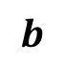

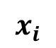
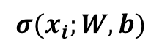
One forward pass
Text (input) representation
TFIDF
Word embeddings
….
0.2 | -0.5 | 0.1
2.0 | 1.5 | 1.3
0.5 | 0.0 | 0.25
-0.3 | 2.0 | 0.0
0.1
0.2
0.3
1.0
3.0
0.025
0.0
0.95
3.89
0.15
0.37
very positive
positive
negative
very negative
$$W$$
$$x_{i}$$
$$b$$
$$σ(x_{i};W, b)$$

Slide 12
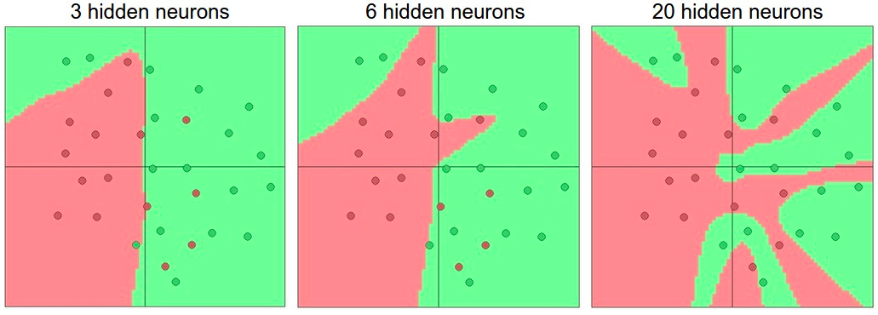
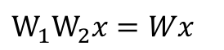
Activation functions
Non-linearities needed to learn complex (non-linear) representations of data, otherwise the NN would be just a linear function
More layers and neurons can approximate more complex functions
$W_{1}W_{2}x=Wx$
http://cs231n.github.io/assets/nn1/layer_sizes.jpeg
Full list: https://en.wikipedia.org/wiki/Activation_function

Slide 13
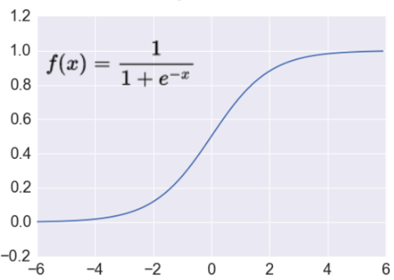
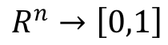
Activation: Sigmoid
Takes a real-valued number and “squashes” it into range between 0 and 1.
$$R^{n}→\left[0,1\right]$$
http://adilmoujahid.com/images/activation.png
Nice interpretation as the firing rate of a neuron
0 = not firing at all
1 = fully firing
Sigmoid neurons saturate and kill gradients, thus NN will barely learn
when the neuron’s activation are 0 or 1 (saturate)
gradient at these regions almost zero
almost no signal will flow to its weights
if initial weights are too large then most neurons would saturate

Slide 14
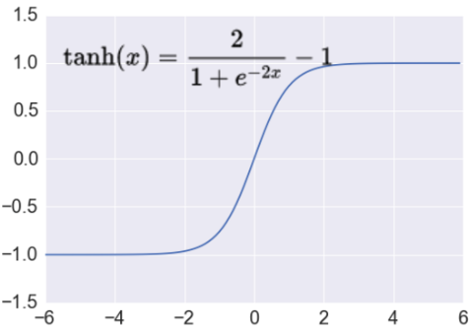
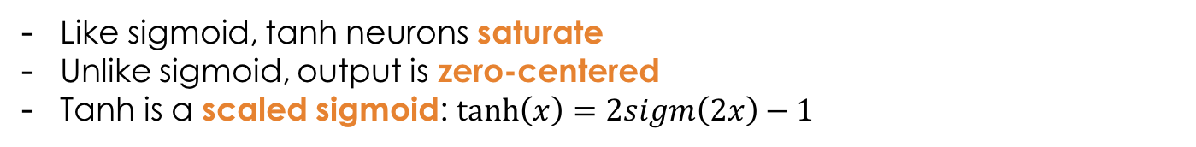
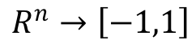
Activation: Tanh
Takes a real-valued number and “squashes” it into range between -1 and 1.
$$R^{n}→\left[−1,1\right]$$
http://adilmoujahid.com/images/activation.png
Like sigmoid, tanh neurons saturate
Unlike sigmoid, output is zero-centered
Tanh is a scaled sigmoid: $\tanh\left(x\right)=2sigm\left(2x\right)−1$
Notes:
not zero-centered: later layers of processing would be receiving data that is not zero-centered.
if data coming into a neuron is always positive then the gradient on the weights will be either all be positive, or all negative (depending on the gradient of the whole expression). Could introduce undesirable zig-zagging dynamics in the gradient weight updates. However, once these gradients are added up across a data batch the final weight update can have variable signs, somewhat mitigating this issue.

Slide 15
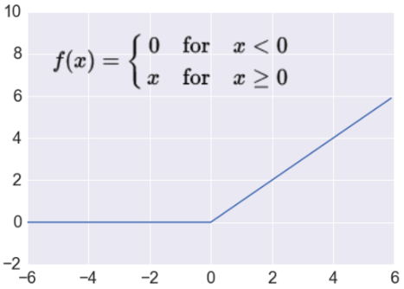
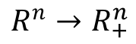
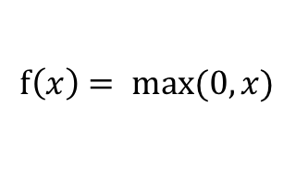
Activation: ReLU
Takes a real-valued number and thresholds it at zero
$$f\left(x\right)= max⁡(0,x)$$
$$R^{n}→R_{+}^{n}$$
http://adilmoujahid.com/images/activation.png
Most Deep Networks use ReLU nowadays
Trains much faster
accelerates the convergence of SGD
due to linear, non-saturating form
Less expensive operations
compared to sigmoid/tanh (exponentials etc.)
implemented by simply thresholding a matrix at zero
More expressive
Prevents the gradient vanishing problem
Notes:
ReLU units can “die”
large gradient flowing through a ReLU could cause weights to update in such a way that the neuron will never activate on any datapoint again
gradient flowing through the unit will forever be zero from that point on
With a proper setting of the learning rate this is less frequently an issue

Slide 16
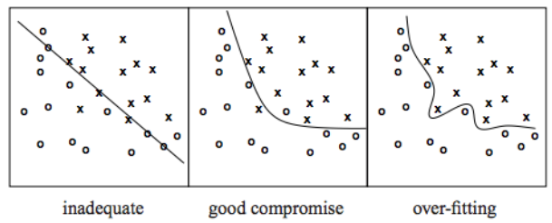
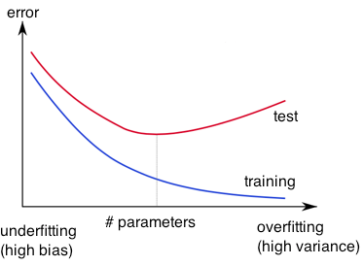
Overfitting
http://wiki.bethanycrane.com/overfitting-of-data
Learned hypothesis may fit the training data very well, even outliers (noise) but fail to generalize to new examples (test data)
https://www.neuraldesigner.com/images/learning/selection_error.svg

Slide 17
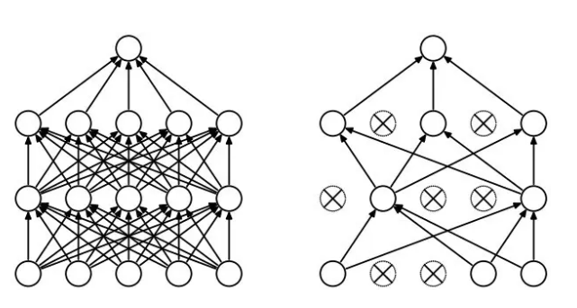
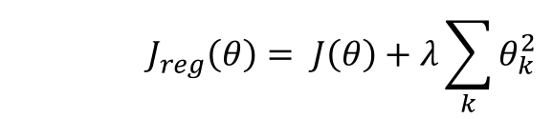
Regularization
Dropout
Randomly drop units (along with their connections) during training
Each unit retained with fixed probability p, independent of other units
Hyper-parameter p to be chosen (tuned)
Srivastava, Nitish, et al. "Dropout: a simple way to prevent neural networks from overfitting." Journal of machine learning research (2014)
L2 = weight decay
Regularization term that penalizes big weights, added to the objective
Weight decay value determines how dominant regularization is during gradient computation
Big weight decay coefficient → big penalty for big weights
$$J_{reg}\left(θ\right)= J\left(θ\right)+λ\sum_{k}{θ_{k}^{2}}$$
Early-stopping
Use validation error to decide when to stop training
Stop when monitored quantity has not improved after n subsequent epochs
n is called patience

Slide 18
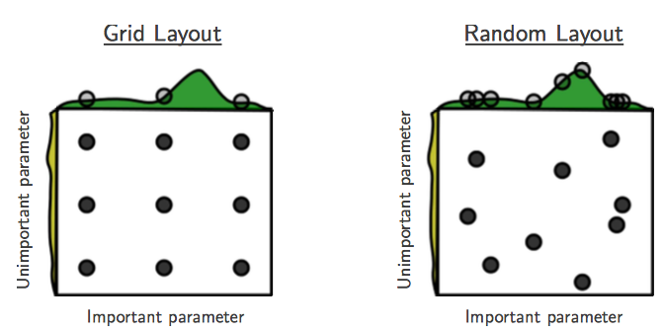
Tuning hyper-parameters
g(x) ≈ g(x) + h(y)
g(x) shown in green
h(y) is shown in yellow
Bergstra, James, and Yoshua Bengio. "Random search for hyper-parameter optimization." Journal of Machine Learning Research, Feb (2012)
“Grid and random search of 9 trials for optimizing function g(x) ≈ g(x) + h(y)
With grid search, nine trials only test g(x) in three distinct places.
With random search, all nine trials explore distinct values of g. ”
Both try configurations randomly and blindly
Next trial is independent to all the trials done before
Bayesian optimization for hyper-parameter tuning:
Make smarter choice for the next trial, minimize the number of trials
Collect the performance at several configurations
Make inference and decide what configuration to try next
Library available!

Slide 19
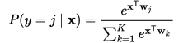

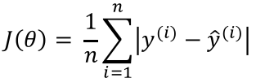
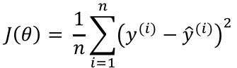
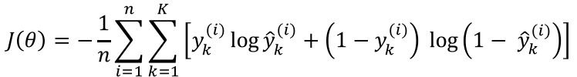
Loss functions and output
Classification
Regression
Training
examples
R^{n} x {class_1, ..., class_n}
(one-hot encoding)
R^{n} x R^{m}
Output
Layer
Soft-max
[map R^{n} to a probability distribution]
Linear (Identity)
or Sigmoid
f(x)=x
Cost (loss)
function
Cross-entropy
Mean Squared Error
$$J\left(θ\right)= \frac{1}{n}\sum_{i=1}^{n}{{\left(y^{(i)}−{\hat{y}}^{(i)}\right)}^{2}}$$
$$J\left(θ\right)=−\frac{1}{n}\sum_{i=1}^{n}{\sum_{k=1}^{K}{\left[y_{k}^{(i)}\log{{\hat{y}}_{k}^{(i)}+\left(1−y_{k}^{(i)}\right) }\log\left(1− {\hat{y}}_{k}^{\left(i\right)}\right)\right]}}$$
Mean Absolute Error
$$J\left(θ\right)= \frac{1}{n}\sum_{i=1}^{n}{\left|y^{(i)}−{\hat{y}}^{(i)}\right|}$$
List of loss functions
Notes:
Exponentiate to make it positive
MSE has nice mathematical properties which makes it easier to compute the gradient
Because of the square, large errors have relatively greater influence on MSE.
Therefore, MAE is more robust to outliers since it does not make use of square.

Slide 20
Where we are
Intro
Example: Facial Recognition
Convolutional Neural Networks
Recurrent Neural Networks, Long-Short Term Memory Networks
Programming with Neural Networks

Slide 21
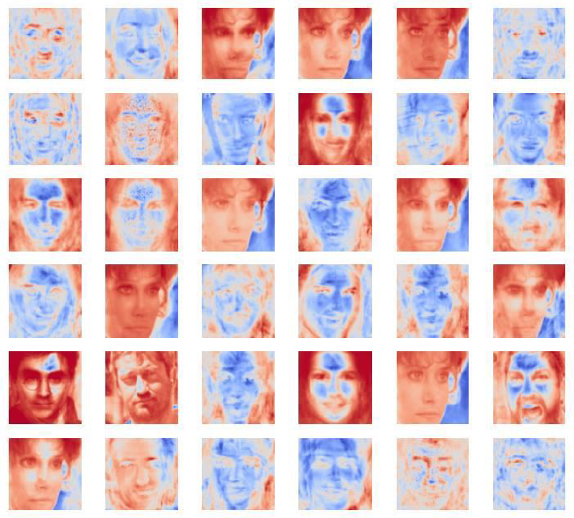
Understanding How Neural Networks See

Slide 22
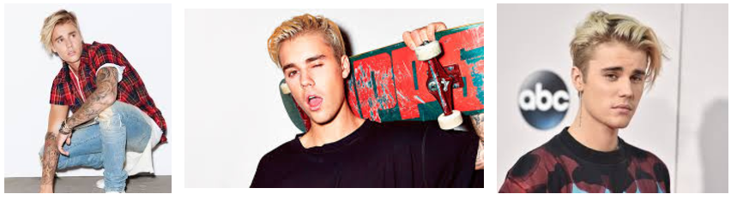
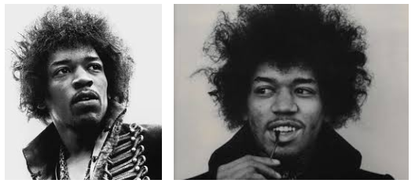
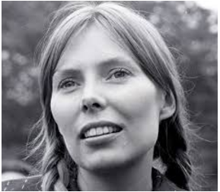
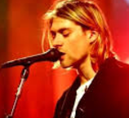
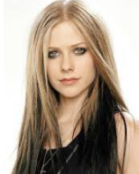
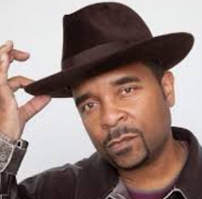
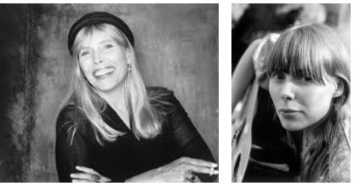
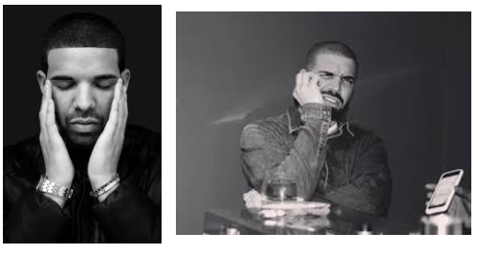
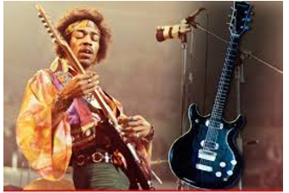
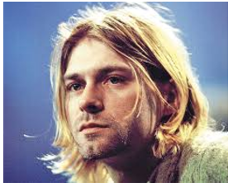
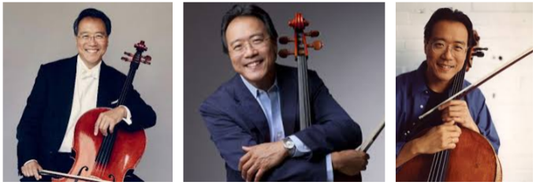
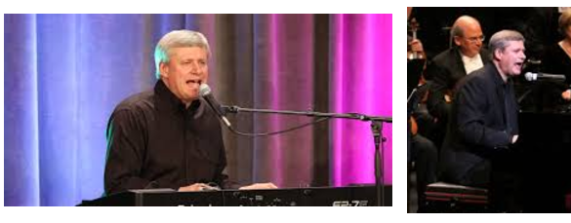




Example: Recognizing Faces

Slide 23

What a celebrity looks like to a computer

Slide 24

The Face Recognition Task
Training set:
$\left\{\left(x^{\left(1\right)}, y^{\left(1\right)}\right),\left(x^{\left(2\right)}, y^{\left(2\right)}\right), …,\left(x^{\left(N\right)}, y^{\left(N\right)}\right)\right\}$
$x^{(i)}$ is a k-dimensional vector consisting of the intensities of all the pixels in in the i-th photo ($20×20$ photo $→$ $x^{(i)}$ is 400-dimensional)
All the photos need to be the same size
Things will be easier if the photos are aligned
$y^{(i)}$ is the label
Test phase:
We have an input vector $x$, and want to assign a label $y$ to it
Who appears in the photo?

Slide 25







First Attempt: 1-Nearest Neighbor
Training set: $\left\{\left(x^{\left(1\right)}, y^{\left(1\right)}\right),\left(x^{\left(2\right)}, y^{\left(2\right)}\right), …,\left(x^{\left(N\right)}, y^{\left(N\right)}\right)\right\}$
Input: $x$
1-Nearest Neighbor algorithm:
Find the training photo/vector $x^{(i)}$ that’s as close as possible to $x$, and output the label $y^{(i)}$
Output: Paul
Closest training image to the input $x$

Slide 26

How close are two images?
Images (represented as k-dimensional vectors) $x^{(0)}$ and $x^{(1)}$ are “close” if $|x^{\left(0\right)}⋅x^{\left(1\right)}|$ is large
(recall $x^{(0)}⋅x^{\left(1\right)}=\sum_{i}{x_{i}^{\left(0\right)}x_{i}^{\left(1\right)}}$)
Assuming $\left|x^{\left(0\right)}\right|=\left|x^{\left(1\right)}\right|=1$
$\frac{x^{(0)}⋅x^{(1)}}{\left|x^{\left(0\right)}\right|\left|x^{\left(1\right)}\right|}$ is the cosine of the angle between $x^{(0)}$ and $x^{(1)}$
What are some other ways of comparing vectors?

Slide 27

What do we need to make this work?
What assumptions about the image data must hold?
All images must be of the same size
If they aren’t, scale/crop them – this can be tricky
It must be the case that if two datapoints (images) $x^{(0)}$ and $x^{(1)}$ are similar in content, $|x^{\left(0\right)}⋅x^{\left(1\right)}|$ is large
When might this not be the case?
The images need to be co-registered (i.e., eyes, mouth, nose, etc. are all always found in the same coordinates, no matter the image)

Slide 28







Concrete task
Training set: 6 actors, with 100 $64×64$photos of faces for each
Test set: photos of faces of the same 6 actors
Want to classify each face as one of 'Fran Drescher', 'America Ferrera’, etc.

Slide 29
Terminology
Neuron = logistic regression or similar function
Input layer = input training/test vector
Bias unit = intercept term/always on feature
Activation = response
Activation function is a logistic (or similar “sigmoid” nonlinearity)
Backpropagation = running stochastic gradient descent across a multilayer network
Weight decay - regularization or Bayesian prior

Slide 30
Deep Learning – what’s different?
Most conventional machine learning works well because of human-designed representations and input features
Machine learning becomes just optimizing weights to best make a final prediction
Representation learning attempts to automatically learn good features or representations
Deep learning algorithms attempt to learn multiple levels of representation of increasing complexity/abstraction

Slide 31














A Simple Neural Network for Face Recognition
$z_{k}$ is the weight associated with the kth actor name
Why this function?
$$z_{k}=σ\left(\sum_{j=1}^{4096}{W^{\left(1, j, k\right)}}x_{j}+b^{\left(1, k\right)}\right)=σ\left(W^{\left(1, ∗, k\right)}⋅x+b^{\left(1, k\right)}\right)$$
$$σ(x)$$
$$x$$
$$b^{(1,3)}$$
$$z_{3}$$
$$z_{6}$$
$$b^{(1,1)}$$
$$z_{1}$$
…
…
outputs (one per actor)
$$W^{(1, 1, 1)}$$
$$W^{(1,4096, 6)}$$
$$x_{1}$$
…
$$x_{20}$$
…
…
…
…
…
…
…
…
$$x_{4096}$$
input vector (flattened 64x64 image)

Slide 32











Training a neural network
Adjust the W’s ($4096×6$ coefs) and b’s (6 coefs)
Try to make it so that if $x$ is an image of actor 1, $z$ is as close as possible to (1, 0, 0, 0, 0, 0) $x$ is an image of actor 2, $z$ is as close as possible to (0, 1, 0, 0, 0, 0) ……
$$b^{(1,3)}$$
$$z_{3}$$
$$z_{6}$$
$$b^{(1,1)}$$
$$z_{1}$$
…
…
outputs (one per actor)
$$z_{k}=σ\left(\sum_{j=1}^{4096}{W^{\left(1, j, k\right)}}x_{j}+b^{\left(1, k\right)}\right)=σ\left(W^{\left(1, ∗, k\right)}⋅x+b^{\left(1, k\right)}\right)$$
$$W^{(1, 1, 1)}$$
$$W^{(1,4096, 6)}$$
$$x_{1}$$
…
$$x_{20}$$
…
…
…
…
…
…
…
…
$$x_{4096}$$
input vector (flattened 64x64 image)

Slide 33

Face recognition
Compute the z for a new image x
If $z_{k}$ is the largest output, output name k
$$b^{(1,3)}$$
$$z_{3}$$
$$z_{6}$$
$$b^{(1,1)}$$
$$z_{1}$$
…
…
outputs (one per actor)
$$z_{k}=σ\left(\sum_{j=1}^{4096}{W^{\left(1, j, k\right)}}x_{j}+b^{\left(1, k\right)}\right)=σ\left(W^{\left(1, ∗, k\right)}⋅x+b^{\left(1, k\right)}\right)$$
$$W^{(1, 1, 1)}$$
$$W^{(1,4096, 6)}$$
$$x_{1}$$
$$x_{20}$$
…
…
…
…
input vector (flattened 64x64 image)
…
…
…
…
…
$$x_{4096}$$
33

Slide 34

An interpretation
$z_{1}$ is large if $W^{\left(1, ∗, 1\right)}⋅x$ is large $z_{2}$ is large if $W^{\left(1, ∗, 2\right)}⋅x$ is large
….
$W^{\left(1, ∗, 1\right)}$, $W^{\left(1, ∗, 2\right)}$, …, $W^{\left(1, ∗, 6\right)}$ are templates for the faces of actor 1, actor 2, …, actor 6
$$b^{(1,3)}$$
$$z_{3}$$
$$z_{6}$$
$$b^{(1,1)}$$
$$z_{1}$$
…
…
outputs (one per actor)
$$z_{k}=σ\left(\sum_{j=1}^{4096}{W^{\left(1, j, k\right)}}x_{j}+b^{\left(1, k\right)}\right)=σ\left(W^{\left(1, ∗, k\right)}⋅x+b^{\left(1, k\right)}\right)$$
$$W^{(1, 1, 1)}$$
$$W^{(1,4096, 6)}$$
$$x_{1}$$
$$x_{20}$$
…
…
…
…
input vector (flattened 64x64 image)
…
…
…
…
…
$$x_{4096}$$
34
34

Slide 35













Visualizing “Face templates”
Baldwin$W^{(1, ∗, 1)}$
Carrel
$$W^{(1, ∗, 2)}$$
Hader
$$W^{(1, ∗, 3)}$$
Ferrera
$$W^{(1, ∗, 4)}$$
Drescher
$$W^{(1, ∗, 5)}$$
Chenoweth
$$W^{(1, ∗, 6)}$$

Slide 36
















Introducing a hidden layer
$$b^{(2,4)}$$
$$z_{1}$$
…
$$z_{4}$$
…
$$z_{6}$$
outputs (one per actor)
$$W^{(2, 1, 1)}$$
$$W^{(2, K, 4)}$$
$$b^{(1,3)}$$
$$b^{(1,1)}$$
$$h_{1}$$
…
$$h_{3}$$
…
…
…
$$h_{K}$$
K hidden units
$$h_{k}=σ\left(W^{\left(1, ∗, k\right)}⋅x+b^{\left(1, k\right)}\right)$$
$$z_{m}=σ(W^{\left(2, ∗, m\right)}⋅h+b^{\left(2, m\right)})$$
$$W^{(1, 1, 1)}$$
$$W^{(1,4096, 6)}$$
$$x_{1}$$
…
$$x_{20}$$
…
…
…
…
…
…
…
…
$$x_{4096}$$
input vector (flattened 64x64 image)

Slide 37


Why a hidden layer?
Instead of checking whether $x$ looks like one of 6 templates, we’ll be checking whether $x$ looks like one of K templates, for a large $K$
If template $k$ (i.e., $W^{(1, ∗, k)}$) looks like actor 6, $W^{(2, k,6) }$will be large

Slide 38

Recap: face recognition for 6 actors
1-Nearest-Neighbor: match $x$ to all the images in the training set
0-hidden-layer neural network*: match $x$ to 6 templates, with one template per actor
The templates work better than any individual photo
1-hidden-layer neural network: match $x$ to $K$ templates
The templates work better than any individual photo
More templates means better accuracy on the training set
More prone to overfitting
*A.K.A. multinomial logistic regression to its friends

Slide 39

Overfitting a one-hidden-layer ANN

Slide 40

Going beyond global templates
Global templates are inflexible
Would like to detect parts of the object in different parts of the image, then “collect” them into detections of eyes, then “collect” detections of eyes into detections of different kinds of faces

Slide 41

A Deep Network
Michael Nielsen
Notes:
This is looking complex. Let’s take a step back and look at which each neuron is doing

Slide 42

Taking a step back: Basic Neuron Model In A Feedforward Network
Inputs x_{i} arrive through pre-synaptic connections
Synaptic efficacy is modeled using real weights w_{i}
The output of the neuron is a nonlinear function f of its weighted inputs
What values of weights would “excite” a neuron? “Inhibit”?
Inputs arise from other neurons or from outside the network. An input may excite or inhibit the response of the neuron to which it is applied, depending upon the weight of the connection
Weights: Learning is the process of modifying the weights in order to produce a network that maximizes (minimizes) some function
Outputs: next slide!

Slide 43
Outputs
Why?
The response function is normally nonlinear
Samples include
Sigmoid
Piecewise linear
ReLU
Notes:
No matter how many linear layers you

Slide 44
Why non-linear activation functions?
We want to model non-linear functions
Otherwise, simpler methods would be faster and easier
Does a deep network of linear layers model non-linear functions?
Every layer is just sums and products, which is still linear…

Slide 45
ReLU is popular
Biological plausibility
One-sided; a neuron is either off or on
Sparse activation
About half of the neurons will be off
Better gradient propagation
Less susceptible to vanishing gradients
Efficient computation
Only comparison, addition and multiplication
Scale-invariant
max(0,a*x)=a*max(0,x) for a >= 0
Why is sparsity important?
What is this?
Notes:
Sparsity:
prevent overfitting – we don’t need L*M*N parameters to learn most functions. Very susceptible to overfitting.
Can reduce training time

Slide 46

What are the hidden units doing?
Templates on top of network: cannot simply treat the $W$s as images
Instead, find the images in the dataset that activate the units the most
Let’s see some visualizations of neurons of a large deep network trained to recognize objects in images
Then network classifies images as one of 1000 objects (sample objects: toy poodle, flute, forklift, goldfish…)
The network has 8 layers
Note: more tricks were used in designing the networks than we have time to mention! In particular, a convolutional architecture is crucial

Slide 47
Example of features in each layer
https://www.cs.princeton.edu/~rajeshr/papers/icml09-ConvolutionalDeepBeliefNetworks.pdf

Slide 48

https://www.cs.princeton.edu/~rajeshr/papers/icml09-ConvolutionalDeepBeliefNetworks.pdf

Slide 49
https://www.cs.princeton.edu/~rajeshr/papers/icml09-ConvolutionalDeepBeliefNetworks.pdf

Slide 50
https://www.cs.princeton.edu/~rajeshr/papers/icml09-ConvolutionalDeepBeliefNetworks.pdf

Slide 51
https://www.cs.princeton.edu/~rajeshr/papers/icml09-ConvolutionalDeepBeliefNetworks.pdf

Slide 52

Units in Layer 3
Matthew Zeiler and Rob Fergus, “Visualizing and Understanding Convolutional Networks” (ECCV 2014)

Slide 53

Units in Layer 4
Matthew Zeiler and Rob Fergus, “Visualizing and Understanding Convolutional Networks” (ECCV 2014)

Slide 54


Units in Layer 5
Matthew Zeiler and Rob Fergus, “Visualizing and Understanding Convolutional Networks” (ECCV 2014)

Slide 55
Where we are
Intro
Example: Facial Recognition
Convolutional Neural Networks
Recurrent Neural Networks, Long-Short Term Memory Networks
Programming with Neural Networks

Slide 56

Convolution Layer
https://devblogs.nvidia.com/parallelforall/deep-learning-nutshell-core-concepts/

Slide 58
Max Pooling layer

Slide 59
Why do max-pooling?
Saves space
Reduces overfitting?
Because I’m going to add more convolutions after it!
Allows the short-range convolutions to extend over larger subfields of the images
So we can spot larger objects
Eg, a long horizontal line, or a corner, or …
At some point the feature maps start to get very sparse and blobby – they are indicators of some semantic property, not a recognizable transformation of the image
Then just use them as features in a “normal” ANN

Slide 61


Slide 62

CNN for text classification
Severyn, Aliaksei, and Alessandro Moschitti. "UNITN: Training Deep Convolutional Neural Network for Twitter Sentiment Classification." SemEval@ NAACL-HLT. 2015.
Notes:
the width m of the convolution filters is set to 5
n = 300 feature maps
first layer embeds words into low-dimensional vectors.

Slide 63

CNN with multiple filters
Kim, Y. “Convolutional Neural Networks for Sentence Classification”, EMNLP (2014)
sliding over 3, 4 or 5 words at a time

Slide 64
Recurrent Neural Networks

Slide 65

Motivation: what about sequence prediction?
What can I do when input size and output size vary?

Slide 66
y₁
h₁
x₁

Slide 67
Sample Feed-forward Network
y₁
h₁
x₁
t = 1

Slide 68
Sample RNN
y₃
y₂
h₃
y₁
h₂
x₃
h₁
t = 3
x₂
x₁
t = 2
t = 1

Slide 69
Sample RNN
y₃
y₂
h₃
y₁
h₂
x₃
h₁
t = 3
x₂
h₀
t = 2
x₁
t = 1

Slide 70
The Vanilla RNN Cell
x_{t}
h_{t-1}
W
h_{t}

Slide 71
The Vanilla RNN Forward
C₁
C₂
C₃
y₁
y₂
y₃
x₁ h₀
x₂ h₁
h₁
x₃ h₂
h₂
h₃

Slide 72
The Vanilla RNN Forward
C₁
C₂
C₃
y₁
y₂
y₃
x₁ h₀
x₂ h₁
h₁
x₃ h₂
h₂
h₃
indicates shared weights
Essentially, copies of the RNN cell are made over time (unrolling/unfolding), with different inputs at different time steps

Slide 73
Sentiment Classification
Classify a restaurant review from Yelp! OR movie review from IMDB OR … as positive or negative
Inputs: Multiple words, one or more sentences
Outputs: Positive / Negative classification
“The food was really good”
“The chicken crossed the road because it was uncooked”

Slide 74
Sentiment Classification
RNN
h₁
The

Slide 75
Sentiment Classification
RNN
RNN
h₁
h₂
The
food

Slide 76
Sentiment Classification
h_{n}
RNN
RNN
RNN
h₁
h₂
h_{n-1}
The
food
good

Slide 77


Sentiment Classification
Linear Classifier
h_{n}
RNN
RNN
RNN
h₁
h₂
h_{n-1}
The
food
good

Slide 78
Sentiment Classification
Ignore
Ignore
Linear Classifier
h₁
h₂
h_{n}
RNN
RNN
RNN
h₁
h₂
h_{n-1}
The
food
good

Slide 79
Sentiment Classification
h = Sum(…)
h₁
h_{n}
h₂
RNN
RNN
RNN
h₁
h₂
h_{n-1}
The
food
good
http://deeplearning.net/tutorial/lstm.html

Slide 80
Sentiment Classification
Linear Classifier
h = Sum(…)
h₁
h_{n}
h₂
RNN
RNN
RNN
h₁
h₂
h_{n-1}
The
food
good
http://deeplearning.net/tutorial/lstm.html

Slide 81

Image Captioning
Given an image, produce a sentence describing its contents
Inputs: Image feature (from a CNN)
Outputs: Multiple words (let’s consider one sentence)
: The dog is hiding

Slide 82
Image Captioning
RNN
CNN

Slide 83
Image Captioning
The
Linear Classifier
h₂
RNN
RNN
h₁
h₂
CNN

Slide 84
Image Captioning
The
dog
Linear Classifier
Linear Classifier
h₂
h₃
RNN
RNN
RNN
h₁
h₂
h₃
CNN

Slide 85

RNN Outputs: Image Captions
Show and Tell: A Neural Image Caption Generator, CVPR 15

Slide 86
RNN Outputs: Language Modeling
VIOLA:
Why, Salisbury must find his flesh and thought
That which I am not aps, not a man and in fire,
To show the reining of the raven and the wars
To grace my hand reproach within, and not a fair are hand,
That Caesar and my goodly father's world;
When I was heaven of presence and our fleets,
We spare with hours, but cut thy council I am great,
Murdered and by thy master's ready there
My power to give thee but so much as hell:
Some service in the noble bondman here,
Would show him to her wine.
KING LEAR:
O, if you were a feeble sight, the courtesy of your law,
Your sight and several breath, will wear the gods
With his heads, and my hands are wonder'd at the deeds,
So drop upon your lordship's head, and your opinion
Shall be against your honour.
http://karpathy.github.io/2015/05/21/rnn-effectiveness/

Slide 87
Input – Output Scenarios
Single - Single
Feed-forward Network
Single - Multiple
Image Captioning
Multiple - Single
Sentiment Classification
Multiple - Multiple
Translation
Image Captioning

Slide 88

Architecture for an RNN
Some information is passed from one subunit to the next
Sequence of outputs
Sequence of inputs
Start of sequence marker
End of sequence marker
http://colah.github.io/posts/2015-08-Understanding-LSTMs/

Slide 89
Architecture for an 1980’s RNN
…
Problem with this: it’s extremely deep and very hard to train

Slide 90





Bidirectional RNNs
Main idea: incorporate both left and right context
output may not only depend on the previous elements in the sequence, but also future elements.
$${\overset{⃑}{h}}_{t}= σ({\overset{⃑}{W}}^{(hh)}{\overset{⃑}{h}}_{t−1}+{\overset{⃑}{W}}^{(hx)}x_{t})$$
$${\overset{⃖}{h}}_{t}= σ({\overset{⃖}{W}}^{(hh)}{\overset{⃖}{h}}_{t+1}+{\overset{⃖}{W}}^{(hx)}x_{t})$$
$$y_{t}=f\left( \left[{\overset{⃑}{h}}_{t}{;\overset{⃖}{h}}_{t}\right] \right)$$
past and future around a single token
http://www.wildml.com/2015/09/recurrent-neural-networks-tutorial-part-1-introduction-to-rnns/
two RNNs stacked on top of each other
output is computed based on the hidden state of both RNNs $\left[{\overset{⃑}{h}}_{t}{;\overset{⃖}{h}}_{t}\right]$

Slide 91

Sequence 2 Sequence or Encoder Decoder model
Try many other models for MT
Cho, Kyunghyun, et al. "Learning phrase representations using RNN encoder-decoder for statistical machine translation." EMNLP 2014

Slide 92


Gated Recurrent Units (GRUs)
Main idea:
keep around memory to capture long dependencies
Allow error messages to flow at different strengths depending on the inputs
Standard RNN computes hidden layer at next time step directly $h_{t}= σ(W^{(hh)}h_{t−1}+W^{(hx)}x_{t})$
Compute an update gate based on current input word vector and hidden state
$$z_{t}= σ(U^{(z)}h_{t−1}+W^{(z)}x_{t})$$
http://www.wildml.com/2015/10/recurrent-neural-network-tutorial-part-4-implementing-a-grulstm-rnn-with-python-and-theano/
Controls how much of past state should matter now
If z close to 1, then we can copy information in that unit through many steps!
Notes:
http://colah.github.io/posts/2015-08-Understanding-LSTMs/

Slide 93

Gated Recurrent Units (GRUs)
Main idea:
keep around memory to capture long dependencies
Allow error messages to flow at different strengths depending on the inputs
Standard RNN computes hidden layer at next time step directly $h_{t}= σ(W^{(hh)}h_{t−1}+W^{(hx)}x_{t})$
Compute an update gate based on current input word vector and hidden state
$$z_{t}= σ(U^{(z)}h_{t−1}+W^{(z)}x_{t})$$
Compute a reset gate similarly but with different weights
$$r_{t}= σ\left(U^{\left(r\right)}h_{t−1}+W^{\left(r\right)}x_{t}\right)$$
http://www.wildml.com/2015/10/recurrent-neural-network-tutorial-part-4-implementing-a-grulstm-rnn-with-python-and-theano/
If reset close to 0, ignore previous hidden state (allows model to drop information that is irrelevant in the future)
Units with short-term dependencies often have reset gates very active
Units with long-term dependencies have active update gates z
Notes:
http://colah.github.io/posts/2015-08-Understanding-LSTMs/

Slide 94

Gated Recurrent Units (GRUs)
Main idea:
keep around memory to capture long dependencies
Allow error messages to flow at different strengths depending on the inputs
Standard RNN computes hidden layer at next time step directly $h_{t}= σ(W^{(hh)}h_{t−1}+W^{(hx)}x_{t})$
Compute an update gate based on current input word vector and hidden state
$$z_{t}= σ(U^{(z)}h_{t−1}+W^{(z)}x_{t})$$
Compute a reset gate similarly but with different weights
$$r_{t}= σ\left(U^{\left(r\right)}h_{t−1}+W^{\left(r\right)}x_{t}\right)$$
New memory ${\tilde{h}}_{t}= tanh(r_{t}∘Uh_{t−1}+Wx_{t})$
Final memory $h_{t}=z_{t}{∘h}_{t−1}+(1−z_{t})∘{\tilde{h}}_{t}$
http://www.wildml.com/2015/10/recurrent-neural-network-tutorial-part-4-implementing-a-grulstm-rnn-with-python-and-theano/
LSTMs are a more complex form, but basically same intuition
GRUs are often more preferred than LSTMs
combines current & previous time steps
Notes:
http://colah.github.io/posts/2015-08-Understanding-LSTMs/

Slide 95


Architecture for an LSTM
“Bits of memory”
Decide what to forget
Decide what to insert
Longterm-short term model
Combine with transformed x_{t}
σ: output in [0,1]
tanh: output in [-1,+1]
http://colah.github.io/posts/2015-08-Understanding-LSTMs/
Notes:
Info is transferred down the chain, not just propagated
Decide when to insert imformation from input into the “backbone”

Slide 96

Walkthrough
What part of memory to “forget” – zero means forget this bit

Slide 97

Walkthrough
What bits to insert into the next states
What content to store into the next state
http://colah.github.io/posts/2015-08-Understanding-LSTMs/

Slide 98

Walkthrough
Next memory cell content – mixture of not-forgotten part of previous cell and insertion
http://colah.github.io/posts/2015-08-Understanding-LSTMs/

Slide 99

Walkthrough
What part of cell to output
tanh maps bits to [-1,+1] range
http://colah.github.io/posts/2015-08-Understanding-LSTMs/

Slide 100
Architecture for an LSTM
(1)
(2)
C_{t-1}
(3)
i_{t}
o_{t}
f_{t}
http://colah.github.io/posts/2015-08-Understanding-LSTMs/
Notes:
Info is transferred down the chain, not just propagated
Decide when to insert imformation from input into the “backbone”

Slide 101
Implementing an LSTM
For t = 1,…,T:
(1)
(2)
(3)
http://colah.github.io/posts/2015-08-Understanding-LSTMs/
Notes:
Info is transferred down the chain, not just propagated
Decide when to insert imformation from input into the “backbone”

Slide 102
Some LSTM Examples
http://karpathy.github.io/2015/05/21/rnn-effectiveness/

Slide 103

LSTMs can be used for other sequence tasks
image captioning
sequence classification
named entity recognition
translation
http://karpathy.github.io/2015/05/21/rnn-effectiveness/

Slide 104

Character-level language model
Test time:
pick a seed character sequence
generate the next character
then the next
then the next …
http://karpathy.github.io/2015/05/21/rnn-effectiveness/

Slide 105

Character-level language model
http://karpathy.github.io/2015/05/21/rnn-effectiveness/

Slide 106

Character-level language model
Yoav Goldberg:
order-10 unsmoothed character n-grams
http://karpathy.github.io/2015/05/21/rnn-effectiveness/

Slide 107


Character-level language model
http://karpathy.github.io/2015/05/21/rnn-effectiveness/

Slide 108

Character-level language model
LaTeX “almost compiles”
http://karpathy.github.io/2015/05/21/rnn-effectiveness/

Slide 109

Character-level language model
http://karpathy.github.io/2015/05/21/rnn-effectiveness/

Slide 110
Where we are
Simple networks
Convolutional neural networks
Generates “more data” to train on
Given one clear image, generate lots of blurry images, blurred in different ways
Recurrent neural networks
When the input is a sequence of variable length
Wrap up

Slide 111
Deep Neural Networks as a Model of Computation
Most people’s first instinct for classifying faces is to write a complicated computer program
A deep neural network is a computer program:
h1 = f1(x)
h2 = f2(h1)
h3 = f3(h2)
…
h9 = f8(h8)
Can think of every layer of a neural network as one step of a parallel computation
Features are the functions that are applied to the previous layers
Learning features ⬄ Learning what function to apply at step t of the algorithm

Slide 112

Deep Neural Networks
Can perform a wide range of computation
Can be learned automatically
(using gradient descent)
Powerful but not (computer) learnable: Python
Can’t make a learning algorithm that takes lots of inputs and outputs and produces Python code that generates the outputs on new inputs
Learnable but not powerful:
Logistic regression
Deep Neural Networks that aren’t deep enough
From Ilya Sutskever

Slide 113
The Deep Learning Hypothesis
Human perception is fast
(Human) neurons fire at most 100 times a second
Humans can solve simple perceptual tasks in 0.1 seconds
So out neurons fire in a sequence of 10 times at most
Success stories:
Classifying images of objects
Classifying Go positions as good or bad
Anything a human can do in 0.1 seconds, a big 10- layer neural network can do, too!

Slide 114
Problems with Supervised Networks
Early layers of the network are not trained well
Diffusion of Gradient – error attenuates as it propagates to earlier layers
Leads to very slow training
Exacerbated since last few layers can usually learn any task "pretty well" and thus the error to earlier layers drops quickly as the top layers "mostly" solve the task– lower layers never get the opportunity to use their capacity to improve results, they just do a random feature map
Need a way for early layers to do effective work
Often not enough labeled data available while lots of unlabeled data
Can we use unsupervised/semi-supervised approaches to take advantage of the unlabeled data
Deep networks tend to have more local minima problems than shallow networks during supervised training

Slide 115
Purely Supervised Learning

Slide 116
Semi-Supervised Learning

Slide 117
Greedy Layer-wise Training
Train each layer in an unsupervised way based on the input of the previous layer
How?
One way: Use an autoencoder: reproduce the input
“Stacked autoencoders”

Slide 118

Stacked autoencoder training
First train this layer

Slide 119

Stacked autoencoder training
First train this layer
Then train this layer

Slide 120

Stacked autoencoder training
First train this layer
Then train this layer
Then train this layer

Slide 121

First train this layer
Then train this layer
Then train this layer
Then train this layer
and finally this layer

Slide 122
Problem
We want to prevent the layers from just learning the identity function and learn interesting features instead
Undercomplete - middle layer smaller than input
Sparsity - penalize hidden unit activations
Use regularization to keep most nodes at or near 0
Denoising - Stochastically corrupt training instance, but train encoder to decode uncorrupted instance
Contractive - force encoder to have small derivatives (stay on manifold)

Slide 123
The point of deep learning frameworks
Easily build big computational graphs
Easily compute gradients in computational graphs
Run it all efficiently on GPU
src: Fei-Fei Li & Justin Johnson & Serena Yeung L, Stanford

Slide 124

src: Fei-Fei Li & Justin Johnson & Serena Yeung L, Stanford

Slide 125

src: Fei-Fei Li & Justin Johnson & Serena Yeung L, Stanford

Slide 126

Problems:
You must compute your own gradient
Can’t run on a GPU
src: Fei-Fei Li & Justin Johnson & Serena Yeung L, Stanford

Slide 127

Construct the graph
Compute the gradients
src: Fei-Fei Li & Justin Johnson & Serena Yeung L, Stanford

Slide 128

Define variables
Graph looks like numpy
Compute the gradients in one call!
src: Fei-Fei Li & Justin Johnson & Serena Yeung L, Stanford

Slide 129

src: Fei-Fei Li & Justin Johnson & Serena Yeung L, Stanford

Slide 130

in pytorch
embedding layer
convolutional layers

